Slide 1

Microsoft 365 Enterprise
Name

Slide 2

Digital transformation

Slide 3


Slide 4

Trends in the workplace
Sense of purpose
Harnessing ingenuity
Multi-generational teamwork
Expertise without boundaries
Increased transparency

Slide 5
Introducing
Microsoft 365
A complete, intelligent solution to empower employees to be creative and work together, securely.
Office 365
Windows 10
Enterprise Mobility + Security

Slide 6

Microsoft 365
A complete, intelligent, secure solution to empower employees
Unlocks creativity
Built for teamwork
Integrated for simplicity
Intelligent security

Slide 7

Unlocks creativity
Work naturally with ink, voice and touch
Visualize information in new ways
Create compelling content with intelligent apps
Build on the work and expertise of others

Slide 8

Built for teamwork
Enterprise-class email, voice and video
Connect everyone with company-wide communities
Share and collaborate on documents in real time
Includes Microsoft Teams, the new chat-based workspace

Slide 9
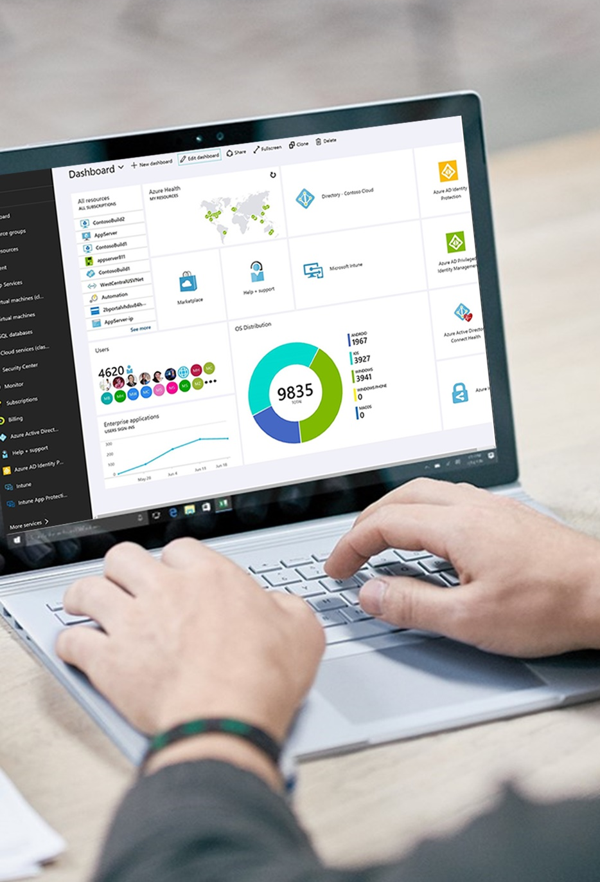
Integrated for simplicity
Always up-to-date
Self-service deployment
Cloud-based management
Rich telemetry from your environment
Reduce TCO with consolidated solutions

Slide 10

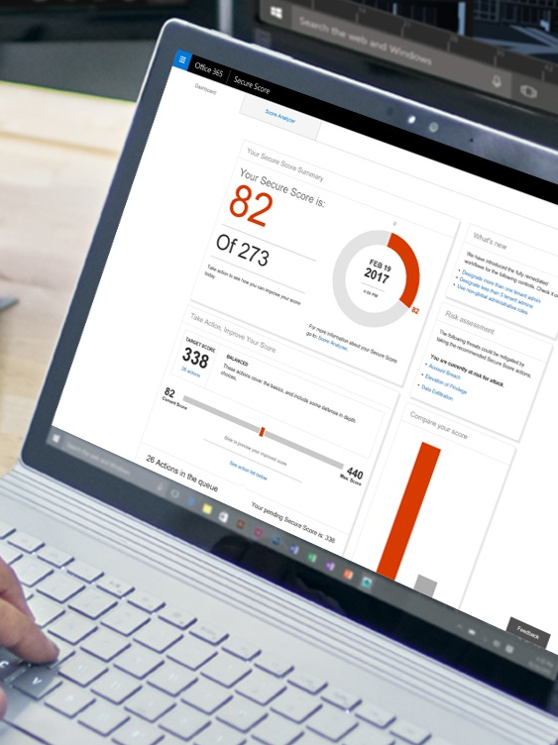
Intelligent security
Protect identity, apps, data & devices
Thwart advanced threats
Manage data archiving, governance & discovery
Powered by Microsoft Intelligent Security Graph
Accelerate GDPR compliance

Slide 11
FastTrack for Microsoft 365
Move to the cloud with confidence
Faster Deployment
Migrate email, content, and light up Microsoft 365 services
Deploy and securely manage devices
Enable your business and gain end-user adoption
Delivered by Microsoft engineers as part of your subscription
Tight integration with qualified partners for additional services
Maximized ROI
Higher Adoption
FastTrack.microsoft.com
Notes:
We’ve designed FastTrack – our customer success service – to help businesses realize business value faster with the Microsoft Cloud. FastTrack can help you:
Migrate email, content, and light up Microsoft 365 services – including assessment and remediation guidance to help prep your infrastructure for the cloud
Deploy and securely manage devices including Microsoft 365 powered devices
Enable your business and gain end-user adoption
FastTrack is an ongoing and repeatable benefit – available as part of your subscription – delivered by Microsoft engineers to help you move to the cloud at your own pace. FastTrack also provides you access to qualified partners for additional services, as needed.
With over 40,000 customers enabled to date, FastTrack helps maximize ROI, accelerate deployment, and increase adoption across your organization.

Slide 12



We use Microsoft 365 Enterprise to foster a modern and highly secure workspace for employees empowered by teamwork and collaboration — everything we need to succeed in a global, digital market.
Bobby Berry, Senior Vice President, Business Solutions

Slide 13
Microsoft 365 Enterprise
Next Steps
Go to Microsoft365.com to learn more
Envision what’s possible with Value Discovery Workshop
Get onboarding and adoption assistance with FastTrack

Slide 15
Microsoft 365 Enterprise
Office 365 Enterprise
Chat- centric workspace
Email & Calendar
Voice, Video & Meetings
Office applications/ co-authoring
Sites & Content Management
Analytics
Advanced Security & Compliance
Enterprise Mobility+ Security
Identity & Access Management
Managed Mobile Productivity
Information Protection
Identity Driven Security
Windows 10 Enterprise
Advanced Endpoint Security
Designed For Modern IT
More Productive
Powerful, Modern devices

